Slide 1
Midterm Checkpoint Presentation
Group members:
Yu Nong
Hanlong Chen

Slide 2


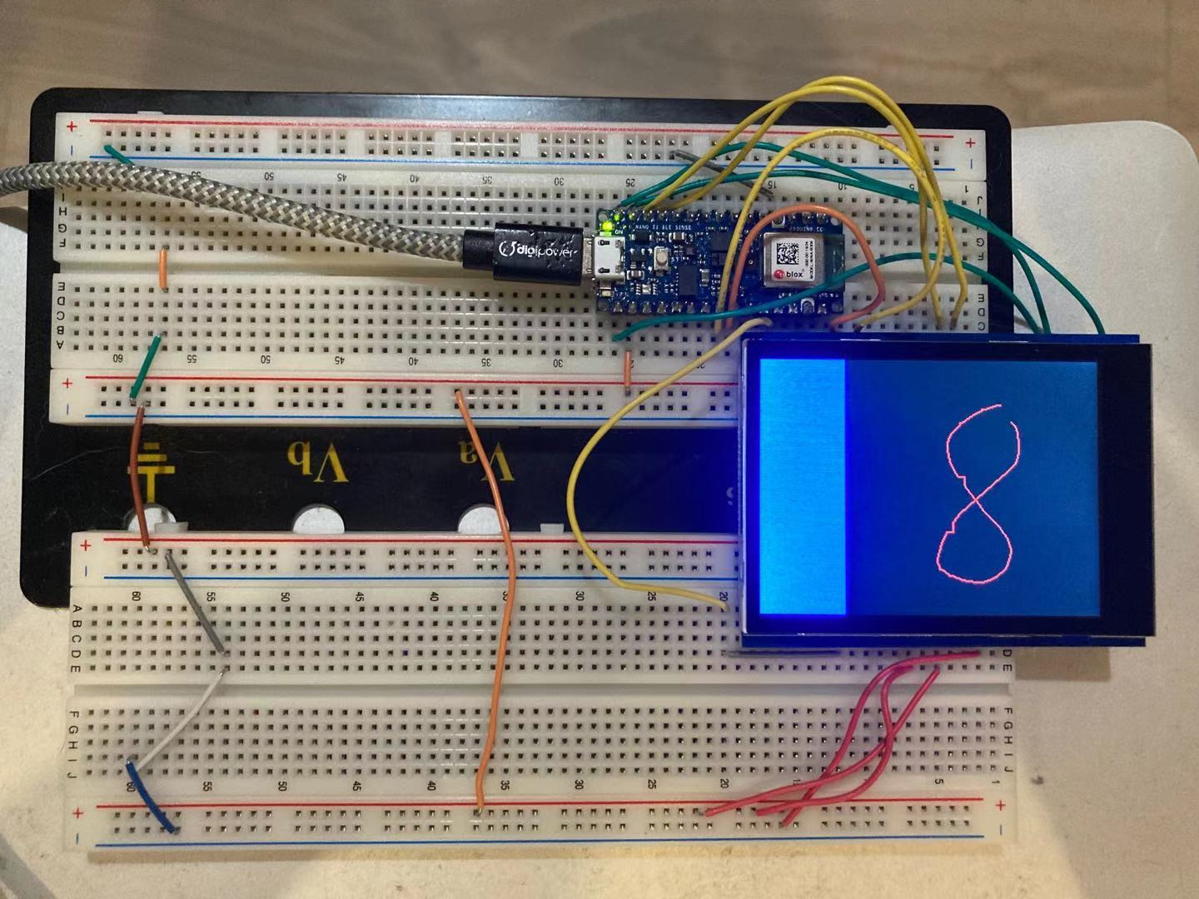
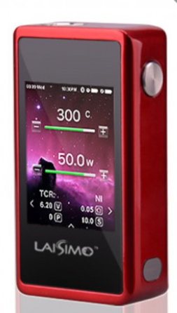
Overall Project Goals and Specific Aims
Goals: Build a low-power and real-time handwritten character recognition system based on Arduino Nano 33 BLE Sense with a touch screen.
Anticipated recognition accuracy: 85%. Anticipated recognition delay: 150 ms.
Deliverables:
BLE

Slide 3
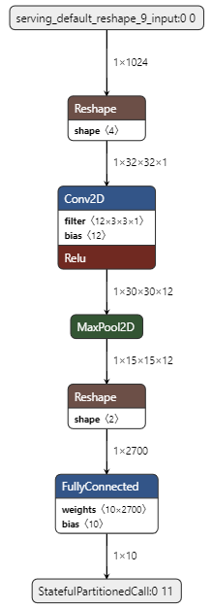
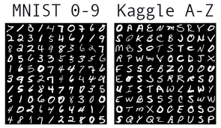


Technical Approach - Deep Learning
Design and train a network from scratch.
Use pre-trained networks and apply transfer learning.
 | Million parameters | Accuracy | Inference time on Arduino
Our network | 0.03-0.1 | ~98% | 30-100ms
MobileNet v1 | 0.47 | ~91% | 650ms
Input: 32*32 grayscale image for our network
96*96 grayscale image for MobileNet
Output: 10 classes
Optimizer: Adam
Loss: Cross entropy

Slide 4
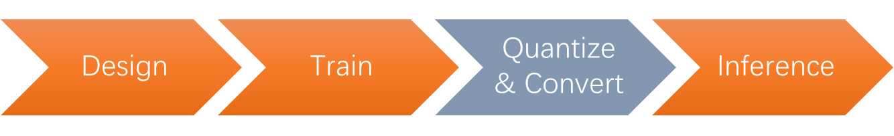

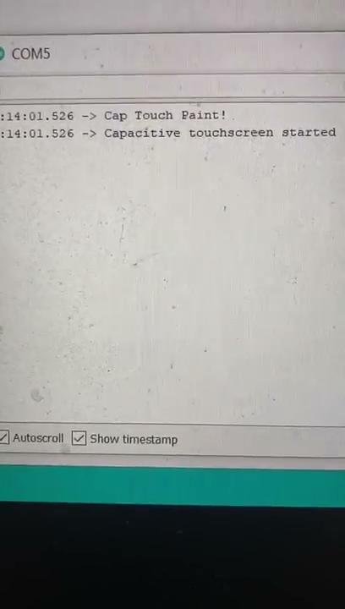

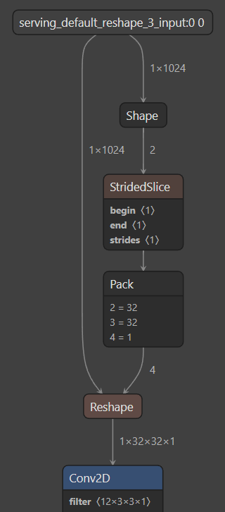
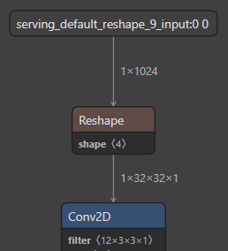
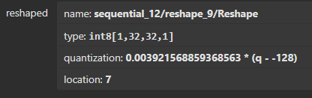

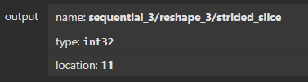
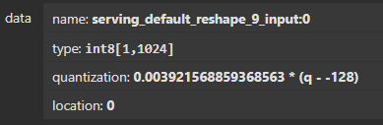
Current Status
Specify batch_size=1 in the reshape layer

Slide 5
Next Step
Continue to tune and compress the model and incorporate recognition of English letter and other characters
Improve the user interface. For example, adding settings that can be adjusted on the touchscreen.
Optimize the integrated system to achieve seamless handwriting input
(Optional) Migrate the system from breadboard to PCB.
(Optional) Design a 3D-printed case for packaging.

